Slide 1

Integrating State Public Policy Resources into Markets
June 2, 2017
Chairman Gladys M. Brown, Pa Public Utility Commission

Slide 2

Wholesale Generation
Pennsylvania is a major exporter of power within the PJM region, with 42.6 GWs of generation, and peak usage of 29.5 GWs in 2015 –
PA’s electricity exports were 38% of PA load in 2016. Our generation fuel mix consists of 32% coal, 26% natural gas, 24% nuclear, 11% oil, and 7% renewables.
As for nuclear generation, PA has 5 plants comprised of 9 units, totaling 9,818 MW of generation capacity.

Slide 3
Wholesale Generation, cont.
From 2007 to 2016, 5,500 megawatts of coal generation was retired in PA.
During the same period, 3,300 megawatts of natural gas generation capacity was constructed here.
An additional 5,000 megawatts of natural gas generation capacity is presently under construction in the state.

Slide 4
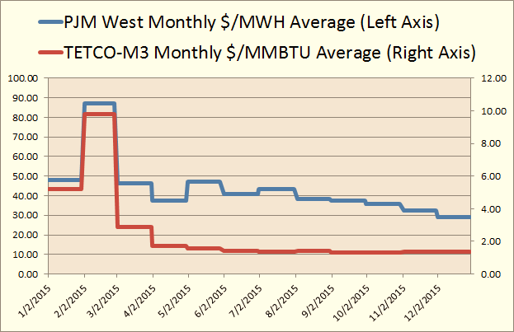
Wholesale Generation, cont.

Slide 5
Wholesale Generation, cont.
    2008
    Henry Hub price averaged $8.86 per MMBTU
    PJM West electricity price averaged $71.13 per MWH
    2016
    Henry Hub price averaged $2.52 per MMBTU
    PJM West electricity price averaged $34.54 per MWH

Slide 6
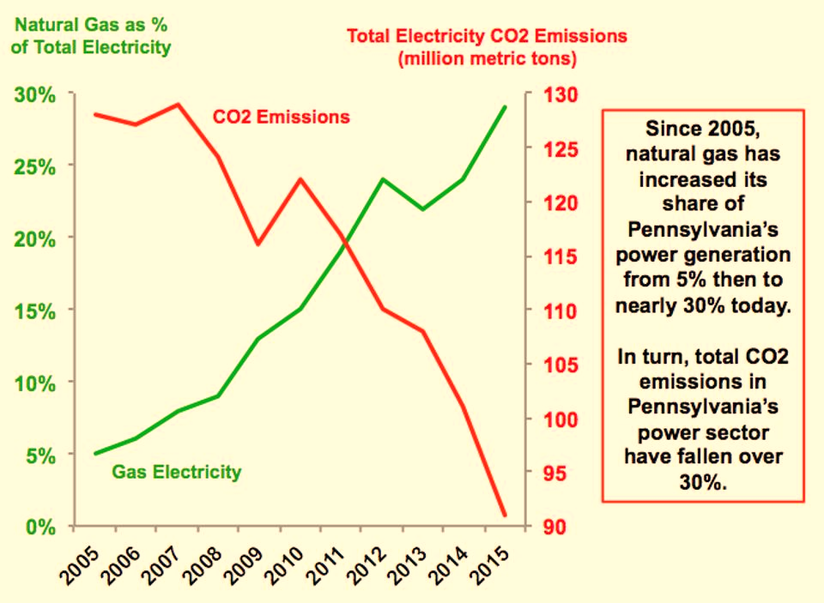
Wholesale Generation, cont.

Slide 7
Wholesale Generation, cont.
The PUC has, at times, protested when a state or market participant attempted to introduce unit-specific subsidies into the market. This goes back to:
New Jersey’s LCAPP
AEP’s and First Energy Solution’s purchased power agreements for nuclear and coal in OH last year.

Slide 8
Wholesale Generation, LCAPP
Amicus filed with U.S. Court of Appeals for the 3rd District during the LCAPP litigation.
PA PUC argued that state-sponsored subsidy programs, like the LCAPP, distort pricing signals by incenting subsidized generators to enter the market below their true economic costs.
Short-term capacity prices would fall, discouraging more efficient generators from the market – jeopardizing reliability and resulting in higher long-term prices.

Slide 9
Wholesale Generation, Ohio PPAs
In both cases, PUC asked that FERC rescind its prior waiver of its affiliate review requirements under Section 205 of the FPA. These PPAs should be reviewed by FERC.
AEP’s and First Energy’s affiliate PPAs run counter to traditional market operations. Subsidization of generation assets that would otherwise be retired will result in distortion of the PJM market.

Slide 10
Act 129
Each of PA’s 7 major EDCs (more than 100,000 customers) now offers efficiency rebates and incentives for all classes.
From June 1, 2016 until May 31, 2021, EDCs will invest over $1.8 billion to support efficiency investments. Expenditures are estimated to return a total benefit to ratepayers of $2.7 billion, resulting in savings of $1.40 for every dollar spent.
Phase II of Act 129 energy efficiency programs (2013-2016) demonstrated savings of approximately $1.70 for every dollar spent.

Slide 11
Act 129
Phase III (2016-2021) energy efficiency goals range from 2.6% - 5% of the EDCs’ 2010 forecasts.

Slide 12
Demand Response
Phase II Act 129 plans did not include a peak demand reduction standard. Peak demand reduction goals have proven cost-effective for 6 of 7 EDCs for the Phase III plans. Goals range from 1.4% - 2.0 % of 2007-2008 peak demand for 6 of 7 EDCs.
Over 5,000 electric accounts in PA currently offer demand response, netting total savings exceeding $1 billion statewide.
PJM’s capacity construct has caused concern for resources like demand response that are primarily available in the summer. These seasonal resources are justifiably worried about declining opportunities in PJM’s capacity market going forward.

Slide 13
CHP-Combined Heat & Power
PA PUC is presently investigating how to increase development above the existing 3,000 megawatts of combined heat and power (CHP).
Last year the PUC issued a Proposed Policy Statement on CHP which recognized its benefits. This initiative is intended to:
  Promote CHP investments;
  Encourage utilities to make CHP an integral part of their energy efficiency and resiliency plans, as well as marketing and outreach efforts;
  Encourage companies to design rates for owners and operators of CHP facilities.
We are currently reviewing comments to this proposal and we look forward to making a final determination this year.

Slide 14
Smart Meters
Each major EDC now has an approved plan to implement advanced meter roll-out. As of June 2016, more than 2.4 million Act 129 compliant meters were installed in the state, representing 49 percent of PA’s meters.
PECO is complete after installing 1.7 million meters; the four FE utilities have installed 800,000 meters; Duquesne 350,000 meters, and PPL 19,000 deployed as of late 2016.
Utilities which have not finalized deployment are well on track to completion by 2021-22, with most estimating full deployment by the close of 2019.

Slide 15
Smart Meters, cont.
When completed, a majority of the state’s EDCs will have meters that can:
  Communicate bi-directionally
  Connect and disconnect remotely
  Provide 15-minute interval data daily to customers, EGSs, and RTOs
  Store usage information in the meter
  Function on open standards and protocols
  Facilitate upgrades as technology advances
  Monitor and report voltage information
  Program themselves remotely
  Communicate outages and restorations
  Net-meter
  Support automatic load control
  Support time-of-use and real-time prices
  Provide the customer with direct access to their usage data

Slide 16
AEPS
Alternative Energy Portfolio Standards (AEPS) Act of 2004, EDCs and EGSs include a specific percentage of electricity from alternative resources in the generation sold to PA customers. These requirements gradually increase over 15 years, peaking at 18 percent by 2021.
Examples of qualifying resources include hydro, geothermal, wind, solar, and biomass. Generation facilities can be located anywhere within the PJM footprint to be eligible under the AEPS.
For the AEPS compliance year ending May 31, 2015, over 16 million AECs were used by over 90 different entities to comply with AEPS.
Approximately 50 percent of credits used for compliance were generated within PA.

Slide 17
AEPS – currently 14.2%
Year | Period | Tier I |  |  | Tier II
 |  | Total | Solar PV | Non-Solar
1 | June 1, 2006 – May 31, 2007 | 1.50% | 0.0013% | 1.4987% | 4.20%
2 | June 1, 2007 – May 31, 2008 | 1.50% | 0.0030% | 1.4970% | 4.20%
3 | June 1, 2008 – May 31, 2009 | 2.00% | 0.0063% | 1.9937% | 4.20%
4 | June 1, 2009 – May 31, 2010 | 2.50% | 0.0120% | 2.4880% | 4.20%
5 | June 1, 2010 – May 31, 2011 | 3.00% | 0.0203% | 2.9797% | 6.20%
6 | June 1, 2011 – May 31, 2012 | 3.50% | 0.0325% | 3.4675% | 6.20%
7 | June 1, 2012 – May 31, 2013 | 4.00% | 0.0510% | 3.9490% | 6.20%
8 | June 1, 2013 – May 31, 2014 | 4.50% | 0.0840% | 4.4160% | 6.20%
9 | June 1, 2014 – May 31, 2015 | 5.00% | 0.1440% | 4.8560% | 6.20%
10 | June 1, 2015 – May 31, 2016 | 5.50% | 0.2500% | 5.2500% | 8.20%
11 | June 1, 2016 – May 31, 2017 | 6.00% | 0.2933% | 5.7067% | 8.20%
12 | June 1, 2017 – May 31, 2018 | 6.50% | 0.3400% | 6.1600% | 8.20%
13 | June 1, 2018 – May 31, 2019 | 7.00% | 0.3900% | 6.6100% | 8.20%
14 | June 1, 2019 – May 31,2020 | 7.50% | 0.4433% | 7.0567% | 8.20%
15 | June 1, 2020 – May 31, 2021 | 8.00% | 0.5000% | 7.5000% | 10.00%

Slide 18
AEPS, cont.
Tier 1 solar credit prices in PA are currently low, trading at $5.50 to $9.00/AEC, oftentimes lower than non-solar Tier 1 resources trading at $6.00 to $8.00/AEC.
Tier 2 resources are also low, $.05 to $0.25/AEC.
Low AEC prices are a result of market over-supply. SB 404, introduced this session, would require solar systems to locate within PA, as opposed to within the larger PJM footprint.

Slide 19
AEPS, Net-Metering
Net-metered customers have increased from just over 4,000 in 2011 to over 10,000 in 2016. The vast majority of these resources are rooftop solar arrays. Federal investment tax credits and the drastic price drop in solar arrays have increased accessibility to the mass market.
Total generation capacity associated with net-metered customers in PA has increased from 83 megawatts to 237 megawatts over the past 6 years.

Slide 20
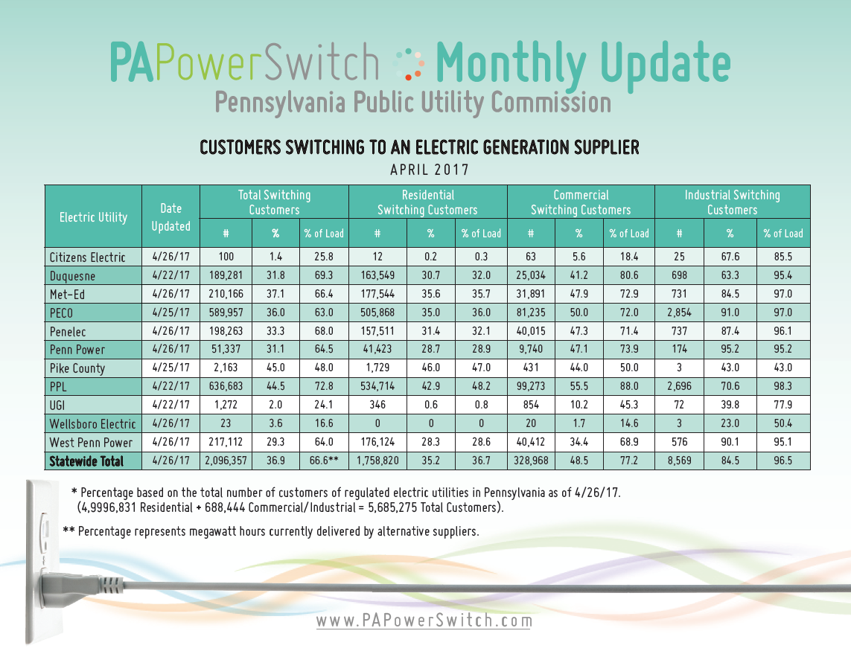
Retail Market

Slide 21
Retail Market – Ratemaking
Advent of distributed generation and increased energy efficiency investments led the Commission to evaluate whether conventional ratemaking principles adequately compensate utilities, as customers consume less electricity.
Over the next five years, the average annual energy usage growth projection for the residential, commercial, and industrial classes in PA is negative 0.09 percent per year.
The number of distributed energy facilities interconnected to the distribution grid has increased from 4,400 in 2011, to 10,600 in 2016. Traditional rate design based on volumetric charges may not allow utilities to cover their fixed costs.

Slide 22
Questions?
www.puc.pa.gov

